Slide 1
The Servlet Model HTTP Methods Form Parameters Requests Responses Servlet Life Cycle

Slide 2
Objectives
How to build the simple web site combining html and servlet?
Http Protocol and Methods
What is Servlet?
Parameters vs. Variables
Servlet Life Cycle
Break down structure component in building web application

Slide 3
Build The Simple Web Requirements
Building the web application can do some following functions as
The user must be authenticated before they want to use this web site using the DB
If the user is invalid, the message “Invalid username and password” is presented, then the link “Click here to try again” is shown that redirect the user to the login page
Otherwise, the search page is redirected.
The GUI of web application is present as following

Slide 4
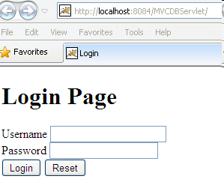
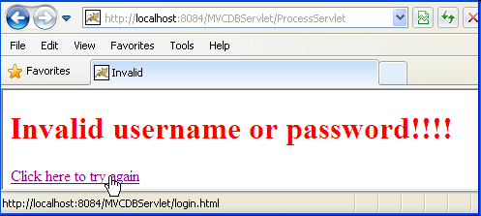
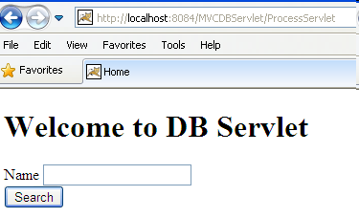
Build The Simple Web Expectation

Slide 5
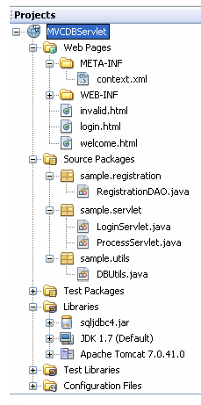
Build The Simple Web Expectation
HTML
Servlet
DB Connection Lib
JDBC Driver

Slide 6
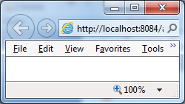
Build The Simple Web Interactive Server Model
2. Send request
Web/App Server
Servlet
1. Click Login
3. Check Login
5. Response the result page
DAO
4. Query DB
6. Browser displays Welcome page/ invalid page
DB
Client
Server

Slide 7
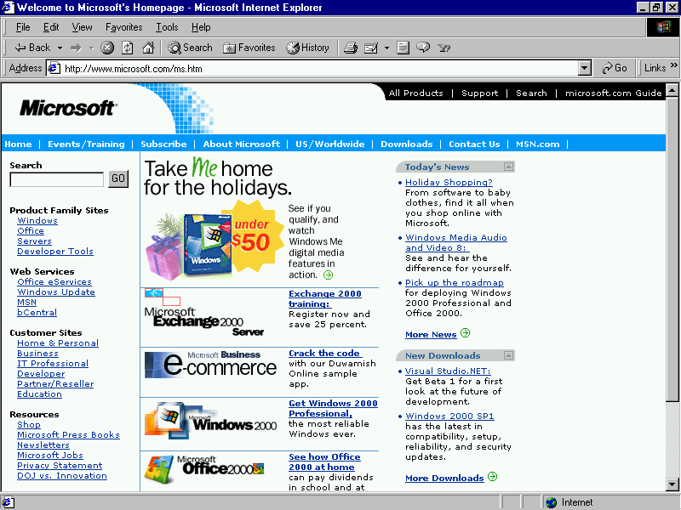
Build The Simple Web Abstraction
Web Server
Container
1. Send request
C
2. Call
3. Query
DB
DAO
5. Response
4. Render/Send
6. Display
V

Slide 8
Build The Simple Web How to Create Web Application Project
Requirement tools: NetBeans IDE 8.x , Java 8
Create a new Web application project
Using Tomcat Server 8.0 or 8.5
JavaEE 6 or 7
Uncheck Deploy on Save

Slide 9
HTML Introduction What is HTML?
HTML is a presentation language for describing web pages.
HTML stands for Hyper Text Markup Language
HTML is not a programming language, it is a markup language
A markup language is a set of markup tags
HTML uses markup tags to describe web pages
HTML Documents = Web Pages
HTML documents describe web pages
HTML documents contain HTML tags and plain text
HTML documents are also called web pages

Slide 10
HTML Introduction HTML Tags
HTML markup tags are usually called HTML tags
HTML tags are keywords surrounded by angle brackets, that begin “<” and finish with “>”, like <html>
HTML tags normally come in pairs like <b> and </b>
The first tag in a pair is the start tag, the second tag is the end tag
Start and end tags are also called opening tags and closing tags.
Web Browser
The purpose of a web browser (like Internet Explorer, or Firefox, etc) is to read HTML documents and display them as web pages.
The browser does not display the HTML tags, but uses the tags to interpret the content of the page

Slide 11
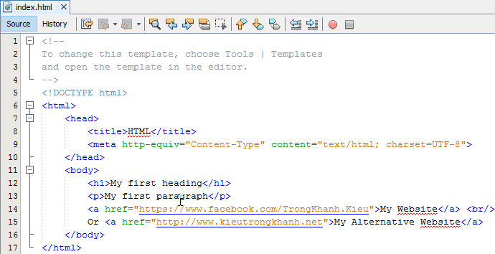
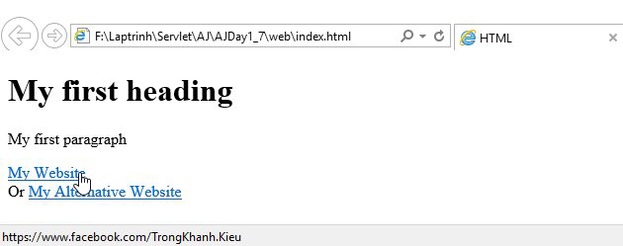
HTML Introduction Example

Slide 12
Form Parameters HTML Form
A form is defined on a web page starting with the opening tag <form> and ending with closing tag </form>
Syntax: <form action=“target” [method=“HTTP method”]>
action attribute presents value that contains some target resource in the web application (e.g. Servlet or JSP)
method attribute denotes the HTTP method to execute. The default is to execute HTTP GET when the form is submitted
Notes: the action parameter obeys the rules
action=“targetServlet”: the browser will assume that targetServlet resides in the same place the default page as index.jsp or index.html
action=“/targetServlet”: the browser will asume the the path at the root location for specified host (http://host:port).
Ex: http://localhost:8086/targetServlet
action=“target?queryString”:the request send the data in queryString to the URL

Slide 13
Form Parameters Input Tag
Is used to input data
Syntax: <input type=“…” [value=“…” name=“…”] />
type attribute
Dedicates to holding a single line of text (text).
The size attribute specifies the width of text field in characters
The maxlength attribute controls the maximum number of characters that a user can type into the text field
A browser should mask the character typed in by the user (password)
Being a hidden field – is invisible (hidden)
Put one or more small boxes that can be clicked to tick or check the corresponding value denote (checkbox)
checked=“checked” sets up the checkbox as already selected
The choice made is mutual exclusive (radio)
The name attribute is crucial to tying together a group of radio buttons
Send the form data to the URL designated by the action attribute (submit)
A request to the client browser to reset all the values within the form (reset)
Defining the “custom button” which is connected to some soft of script (button)
name attribute supplies the parameter name
value attribute supplies the parameter value

Slide 14
Form Parameters Select & Text Area Tag
HTML Forms – select tag
Sets up a list of values to choose (combo box or pop-up menu, or list box)
Syntax: <select name=“…” [size=“…” multiple] > <option value=“…” [selected]>…</option> … </select>
option tag
The user-visible text goes between opening and closing option tag
The value attribute passes the value in the parameter
multiple attribute presents the control that can choose more than one
HTML Forms – textarea tag
Presents multiple line of text
Syntax: <textarea name=“…” rows=“…” cols=“…”> … </textarea>
The text value put in opening and closing tag is passed as the parameter value to server
rows present the number of visible lines
cols present the number of characters to displayed across the width of the area

Slide 15
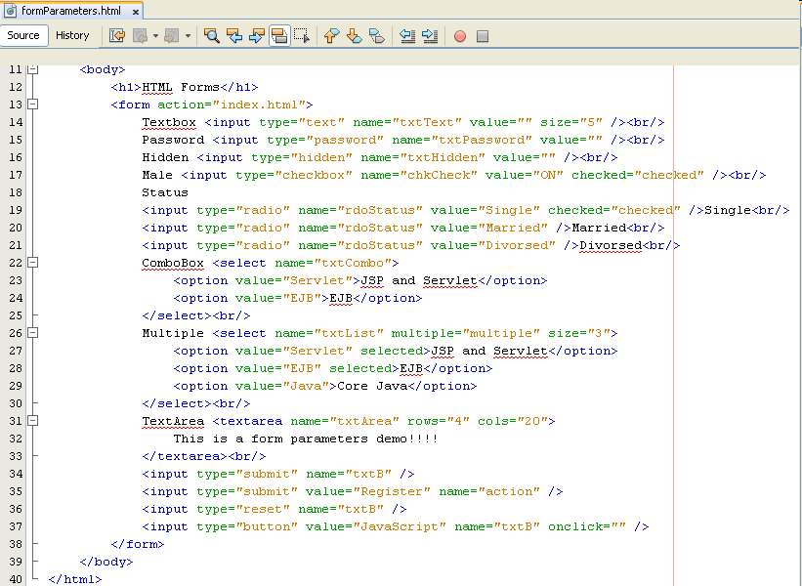
Form Parameters Examples

Slide 16
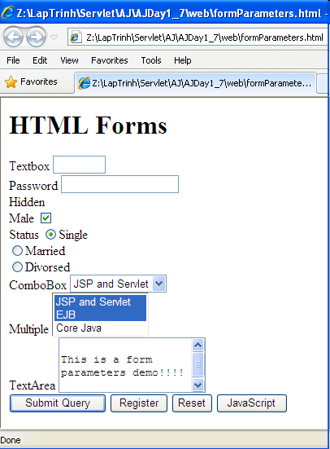
Form Parameters Examples

Slide 17
Build The Simple Web Views

Slide 18
Build The Simple Web Interactive Server Model
2. Send request
Web/App Server
Servlet
1. Click Login
5. Response the result page
3. Check Login
DAO
4. Query DB
6. Browser displays Welcome page/ invalid page
DB
Client
Server

Slide 19
HTTP Protocols Overview
1. Convert http://microsoft.com/ to 192.168.54.3:80
Connect
2. Send a request to Web Server (index.html)
4. The result is responsed to Browser
http://microsoft.com/index.html
192.168.54.3:80
5. Web Browser views the result which contains a markup language
3. Web Server processes a request (connecting DB, calculating, call service …)
Request – Response pairs
Stateless
Port 80 is default

Slide 20
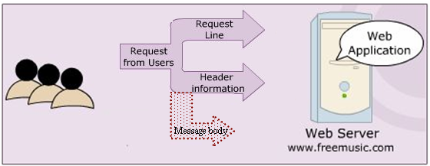
HTTP Protocols HTTP Requests
The HTTP method
A pointer to the resource requested, in the form of a URI
The version of HTTP protocol
Ex: GET /index.html HTTP/1.1
A carriage return/ line feed

Slide 21
HTTP Protocols HTTP Requests
Return the User-Agent (the browser) along with the Accept header in the form name:value (provides information on what media types the client can accept)
Ex: User-Agent: Mozilla/4.0 (compatible: MSIE 4.0 : Windows 95) Accept : image/gif, image/jpeg, text/*, */*
A carriage return/ line feed

Slide 22
HTTP Protocols HTTP Requests
A carriage return/ line feed
Contain pretty much any thing (a set of parameters and values, an image file intending to upload)

Slide 23
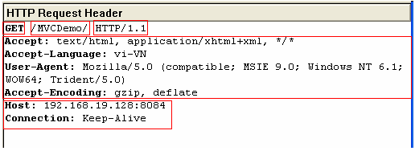
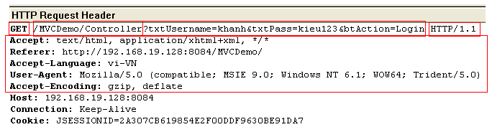
HTTP Protocols HTTP Requests – Example

Slide 24
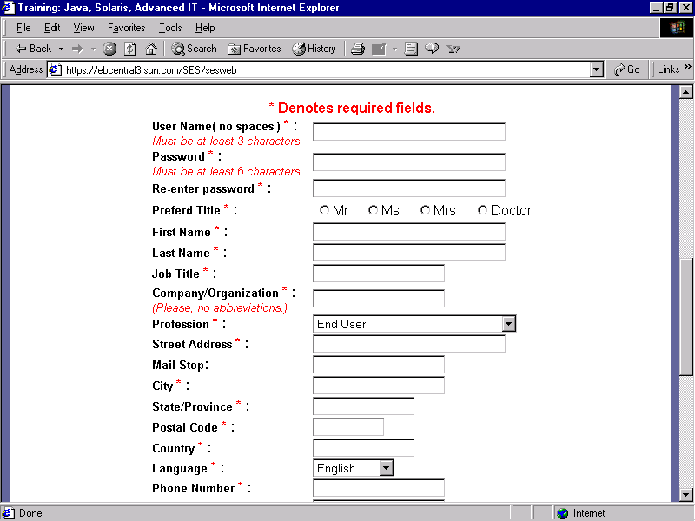
The Servlet Model Request Objects
1. Input and click button/link
3. Send request
4. Dispatch to Servlet/Web Container
Web/App Server
Containter
Request Object
5. Container create Req Obj
2. Generate the Request msg
10. Send response
6. Forward
Response Object
Resources
9. Create Response Msg
8. Set Val
OS
7.retrieve data (if any)
DB
Client
Server
Notes:
Dispatch : gửi đi

Slide 25
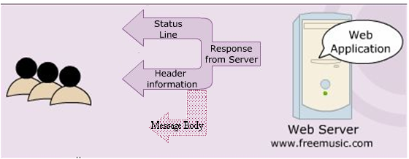
HTTP Protocols HTTP Responses
Blank line

Slide 26
HTTP Protocols HTTP Responses
Indicates status of request process (HTTP version, response code, status)
Ex: HTTP/1.1 200 OK
Blank line
Server. Ex: Server: JavaWebServer
Last modified date.
Ex: Last-modified: Tuesday, 24-Mar-09 8:30:34 GMT
Content length. Ex: Content-length: 100
Content type. Ex: Content-type: text/plain

Slide 27
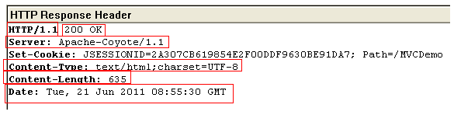
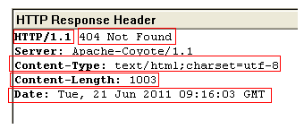
HTTP Protocols HTTP Responses – Example

Slide 28
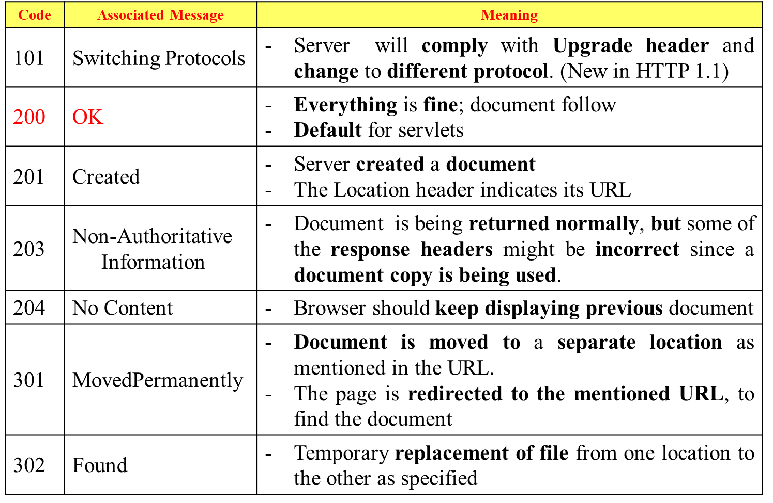
HTTP Protocols Some commonly Status codes
Notes:
Comply : tuân theo

Slide 29
HTTP Protocols Some commonly Status codes
Status code | Associated Message | Meaning
400 | Bad Request | - The request placed is syntactically incorrect
401 | Unauthorized | - Authorization not given to access a password protected page
403 | Permission denied | - Authentication but authorization not given to access protected resource
404 | Not Found | - Resource not found in the specified address
408 | Request Timeout | - Time taken by client is very long to send the request (only available in HTTP 1.1)
500 | Internal Server Error | - Server is unable to locate the requested file. The servlet has been deleted or crashed or had been moved to a new location with out informing
503 |  | Indicates that the HTTP server is temporarily overloaded, and unable to handle the request
… | … | …

Slide 30
HTTP Protocols HTTP Methods – Basic
GET
Is the method commonly used to request a resource/ get information (access static resource such as HTML doc and images or retrieve dynamic information such as query parameters) from server
The restricted length of query string, that is introduced by the question mark “?”
Is trigger by
Typing into the address line of the browser and pressing GO
Clicking on a link in a web page
Pressing the submit button in an HTML form with GET method
POST
Sends data of unlimited length to the web server.
Is the method commonly used for passing user input / sending information to the server (access dynamic resources and enable secure data in HTTP request because the request parameters are passed in the body of request)
No limit and cannot be booked mark or emailed

Slide 31
HTTP Protocols HTTP Methods – Extends
HEAD
Returns the headers identified by the request URL.
Is identical to the GET method but it doesn’t return a message body
Is an economical way of checking that a resource is valid and accessible
OPTIONS
Returns the HTTP methods the server supports.
PUT
Requests the server to store the data enclosed in the HTTP message body at a location provided in the request URL.
DELETE
Requests the server to delete the resource identified by the request URL.
TRACE
Is used for debugging and testing the request sent to the server. It is useful when the request sent to the server reaches through the proxies.
Idempotency and Safety
GET, TRACE, OPTIONS, and HEAD
Notes:
Idempotency and Safety : Bình đẳng và An toàn

Slide 32
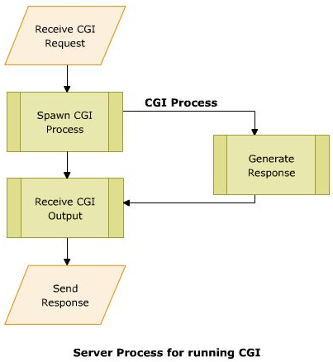
The Servlet Model Common Gateway Interface (CGI)
A small program (*.exe) is written in languages such as C/C++, Perl, ... for the gateway programs.
Used in complex applications, such as Web pages
A set of standards followed to interface applications form client side to a Web Server
Enables the Web server to send information to other files and Web browsers
Helps to process the inputs to the form on the Web page
Enables to obtain information and use it on the server machine (server side)
When the Browser sends request to server, CGI instantaties to receive and process.

Slide 33
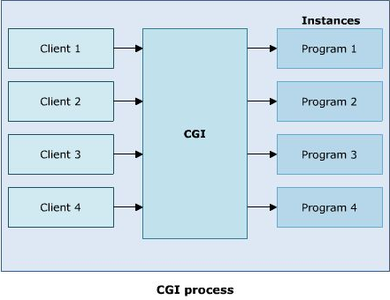
The Servlet Model Common Gateway Interface (CGI)
Disadvantages
Reduced efficiency

Slide 34
The Servlet Model Common Gateway Interface (CGI)
Disadvantages (cont.)
Reduced efficiency
Reloading Perl interpreter
The widely accepted platform for writing CGI script is Perl. Each time the server receives are quest, the Perl interpreter needs to be reloaded.
Interactive: not suitable for graphical or highly interactive programs
Time consuming and more memory consumed
Debugging: error detection is difficult
Not support Session
Notes:
Interactive : tương tác

Slide 35
The Servlet Model Servlets
Are Java classes that dynamically process HTTP requests and construct responses
Are Java codes that are used to add dynamic content to Web server.
There is only a single instance of Servlet created on the Web server.
To service multiple clients’ request, the Web server creates multiple threads for the same Servlet instance (Overcome CGI’s consumed more memory)
Gets auto refreshed on receiving a request each time
A Servlet’s initializing code is used only for initializing in the 1st time
Merits
Enhanced efficiency (initializing only once, auto refresh)
Ease to use (using Java combining HTML)
Powerful (using Java)
Portable
Safe and cheap
Demerits
Low-level HTML documentation (Static well-formed-ness is not maintained)
Unclear-session management (flow of control within the codes is very unclear)
Notes:
-Tài liệu HTML cấp thấp (Tính ổn định tĩnh không được duy trì)
-Quản lý phiên không rõ ràng (luồng kiểm soát trong mã rất không rõ ràng)

Slide 36
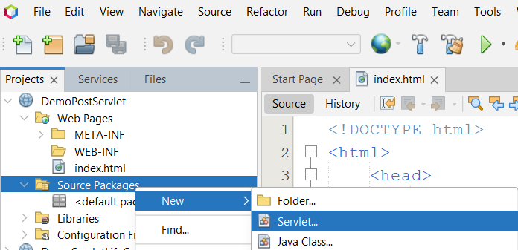
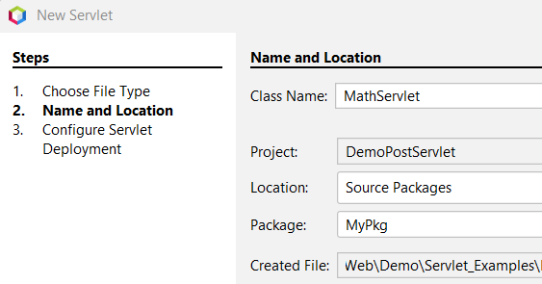
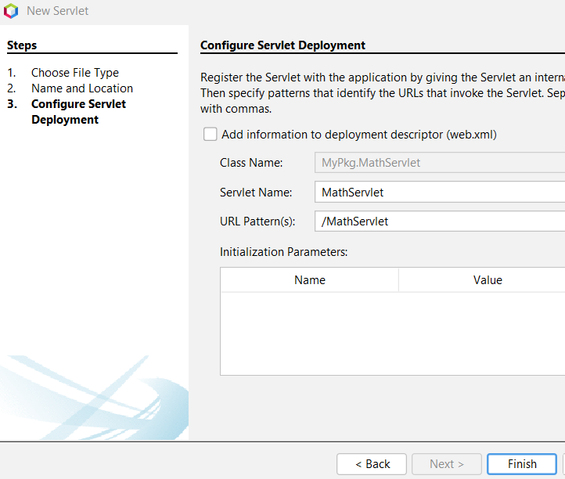
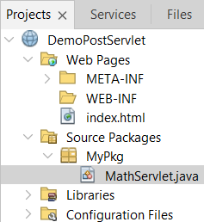
The Servlet Model Servlets
2
1
3
4
3

Slide 37
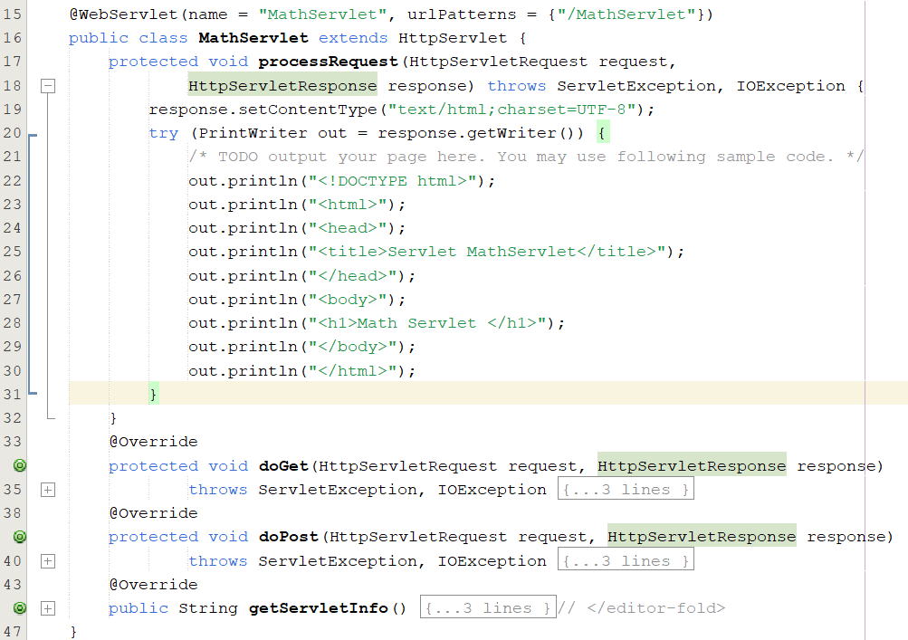
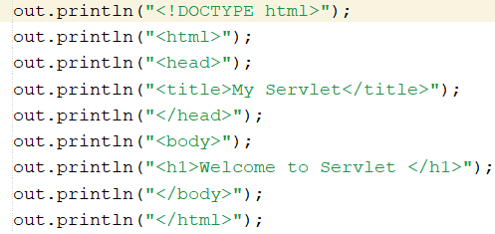
The Servlet Model Servlets
5

Slide 38
The Servlet Model Servlets
How to server detecting the servlets (difference from Java class), then, initializing in the 1st time?
Web deployment descriptors (web.xml)
Annotations

Slide 39
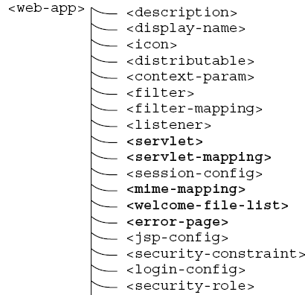
The Servlet Model The Deployment Descriptor
The Web Deployment Descriptor file describes all of Web components
It is an XML file. Given that the name is web.xml.

Slide 40
The Servlet Model The Deployment Descriptor – web.xml
<?xml version="1.0" encoding="UTF-8"?>
<web-app version="2.5" xmlns="http://java.sun.com/xml/ns/javaee" xmlns:xsi="http://www.w3.org/2001/XMLSchema-instance" xsi:schemaLocation="http://java.sun.com/xml/ns/javaee http://java.sun.com/xml/ns/javaee/web-app_2_5.xsd">
<servlet>
<servlet-name>servlet name</servlet-name>
<servlet-class>package.classname</servlet-class>
</servlet>
<servlet-mapping>
<servlet-name>servlet name</servlet-name>
<url-pattern>/context Path/root</url-pattern>
</servlet-mapping>
<session-config>
<session-timeout>30</session-timeout>
</session-config>
<welcome-file-list>
<welcome-file>default page to show</welcome-file>
</welcome-file-list></web-app>
Servlets Declaration is same as package.classname servlet_name;
Define the access path to the servlet;

Slide 41
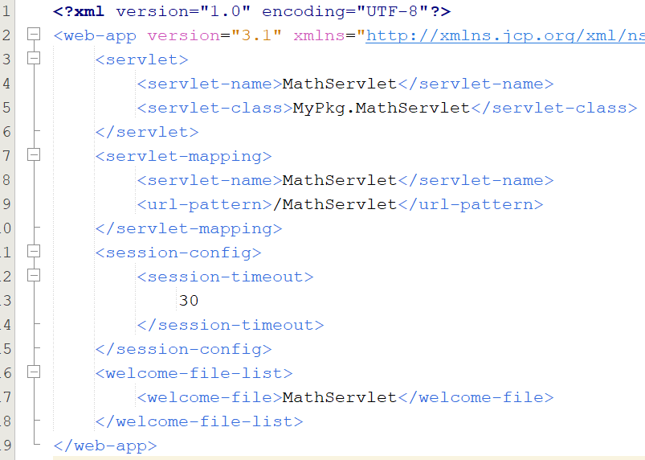
The Servlet Model The Deployment Descriptor – Example
-Open the web.xml in the WEB-INF then update as follows:
6
-Right-click on the project , select Run

Slide 42
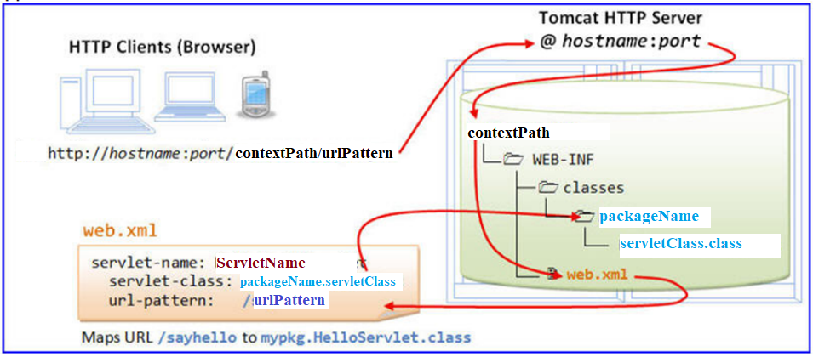
The Servlet Model The Deployment Descriptor – Example
2. Send Request
3. Dispatch to Application
1. User types url
4. Find web.xml
6. Access the servlet instance
5. Look up the servlet class from mapping to find the servlet instance web.xml

Slide 43
The Servlet Model Annotations
Are one of the major advancement from Java EE 5.0 that makes the standard web.xml deployment descriptors files optional
To avoid writing such kind of unnecessary codes, annotations are used
Can be defined as metadata information that can be attached to an element within the code to characterize it
Simplifies the developer’s work to a great extent by significantly reducing the amount of code to be written by moving the metadata information into the source code itself
Are never executed and processed when the code containing it are compiled or interpreted by compilers, deployment tools, and so on
An annotation type takes an ‘at (@)’ sign, followed by the interface keyword and the annotation name

Slide 44
The Servlet Model Annotations – Servlets
WebServlet
Is used to provide the mapping information of the Servlet.
Is processed by the servlet container at the time of the deployment.
Attributes | Descriptions
name | Specifies the Servlet name. This attribute is optional.
urlPatterns | An array of url patterns use for accessing the Servlet, this attribute is required and should register one url pattern
initParams | An array of @WebInitParam, that can be used to pass servlet configuration parameters. This attribute is optional.
…

Slide 45
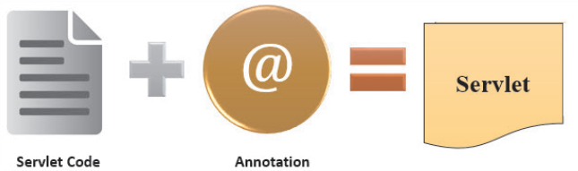
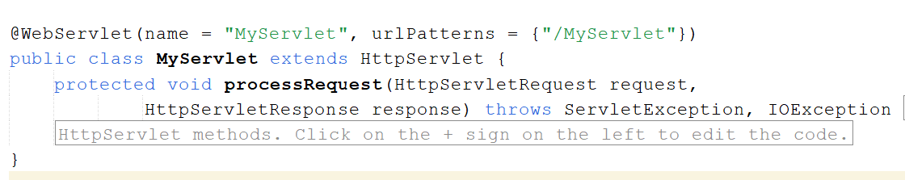
The Servlet Model Annotations – Servlets
The javax.servlet.annotation package provides annotations to declare Servlets by specifying metadata information in the Servlet class
Figure 4.9: Servlet with Annotations, Web Component Development Using Java

Slide 46
The Servlet Model Servlets
Web
Server
Browser
Client
1. Send Request
Internet HTTP Protocol
2. Choose Servlet Instance
4. Response
ServletContainer
Servlets
3. Query (if any)
Database

Slide 47
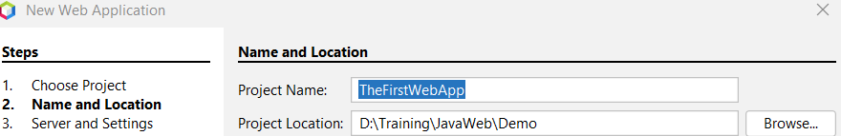
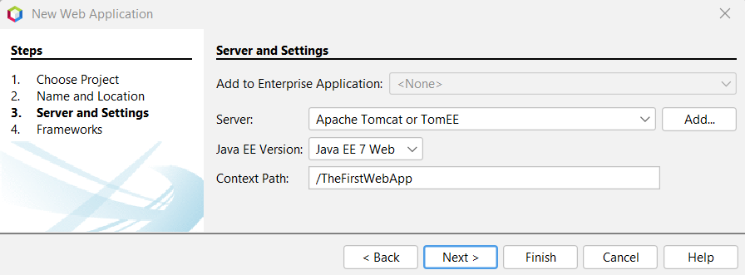
Demo : Create a Servlet
Step 1 : Create Java Web Application
Open the NetBean | File | New Project, select Java with Ant | Java Web | Web Application, click Next
On the New Web Application dialog, enter the Project Name is “TheFirstWebApp”, and enter the path to store project to the Project Location then click Next.
Check Tomcat Server and Java EE version , then click Finish to create the web project

Slide 48
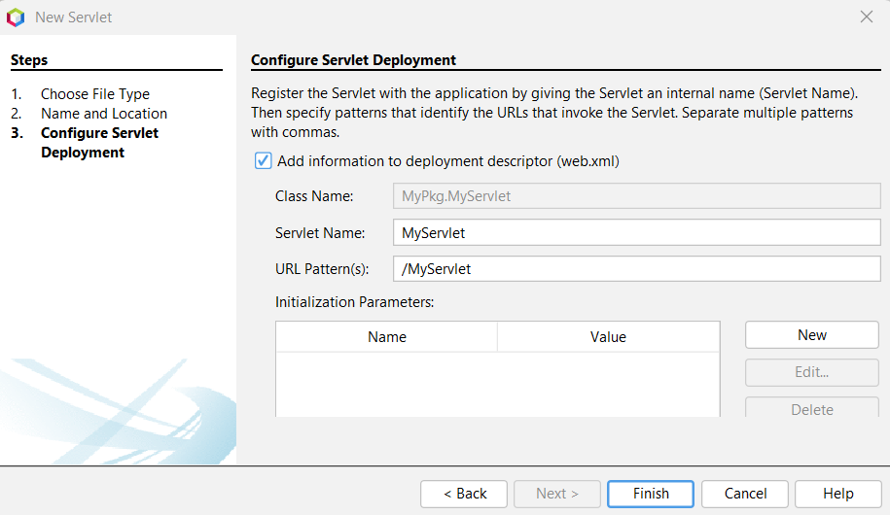
Demo:Create a Servlet
Step 2 : Create a Servlet named MyServlet
On the project, right-click on the Source Packages | New | Servlet, enter Class Name is MyServlet and Package is MyPkg then click Next, and follow the instructions as shown below, click Finish

Slide 49
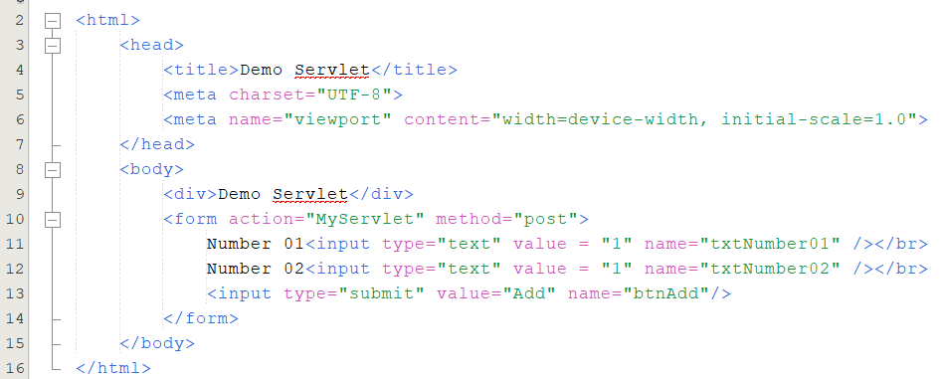
Demo:Create a Servlet
Step 3: Open the index.html then write codes as follows:

Slide 50
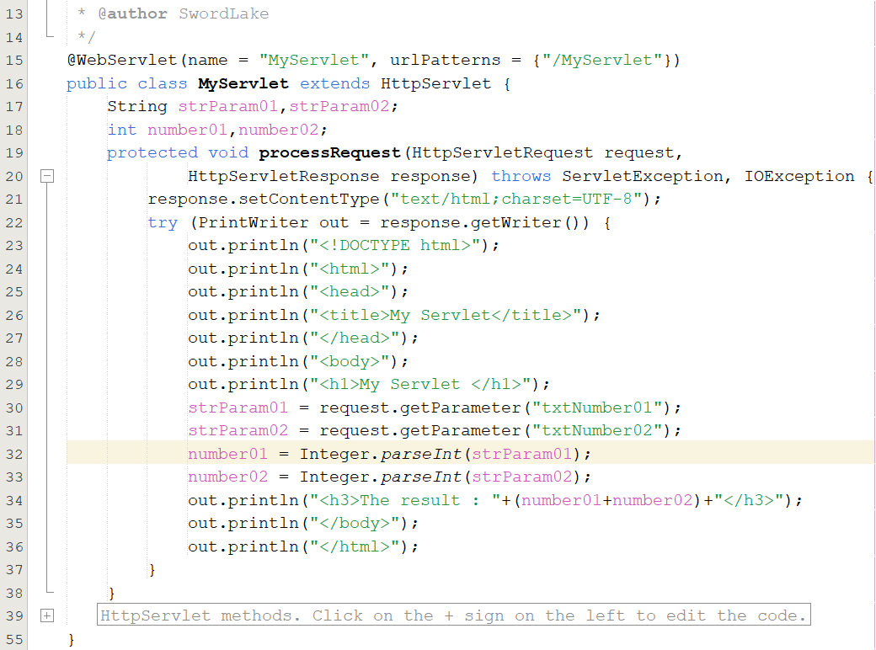
Demo:Create a Servlet
Step 4 : Update codes of the MyServlet.java
Open the MyServlet.java, and update the codes as the follows:

Slide 51
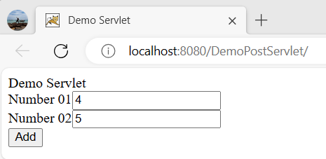
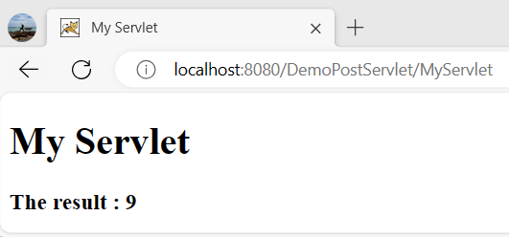
Demo:Create a Servlet
Step 5 : Right-click on the project | Run

Slide 52
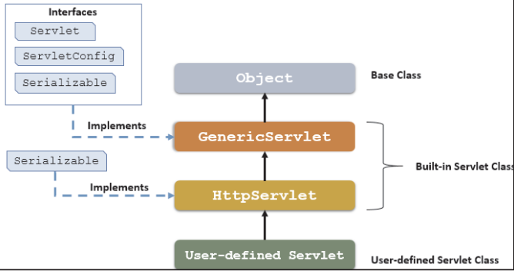
The Servlet Model Architecture of the Servlet packages
The javax.servlet package provides interfaces and classes for writing servlets
The important interface is javax.servlet.Servlet
When a servlet accepts a call from a client, it receives two objects:
ServletRequest, which encapsulates the communication from the client to the server.
ServletResponse, which encapsulates the communication from the servlet to the client.

Slide 53
The Servlet Model GenericServlet class
Defines a servlet that is not protocol dependent
Implements the Servlet, the ServletConfig, and the java.io.Serializable interfaces
Retrieves the configuration information by implementing the ServletObject
Some methods
Methods | Descriptions
init | - public void init() throws ServletException - Initializes the servlet
service | - public abstract void service(ServletRequest req, ServletResponse res) throws ServletException, IOException - Called by the container to respond to a servlet request
destroy | - public void destroy(): cleaning the servlet
Servlet
Life
Cycle
defined
in Generic

Slide 54
The Servlet Model The Servlet Life Cycle
5. first to n^{th} req
Uninstantiated
Instantiation
Initialization
meet request
1. begin to deploy
Meet multi request
2. deploying
success
init()
success
service()
4. first req
3. deployed
failure
Detroy received request and using thread
failure
Unload
Unavailable
destroy
6. undeploy, server is crashed, unload servlet
destroy()
The life cycle is defined by
init() – called only one by the server in the first request
service() – process the client’s request, dispatch to doXXX() methods
destroy() – called after all requests have been processed or a server-specific number of seconds have passed

Slide 55
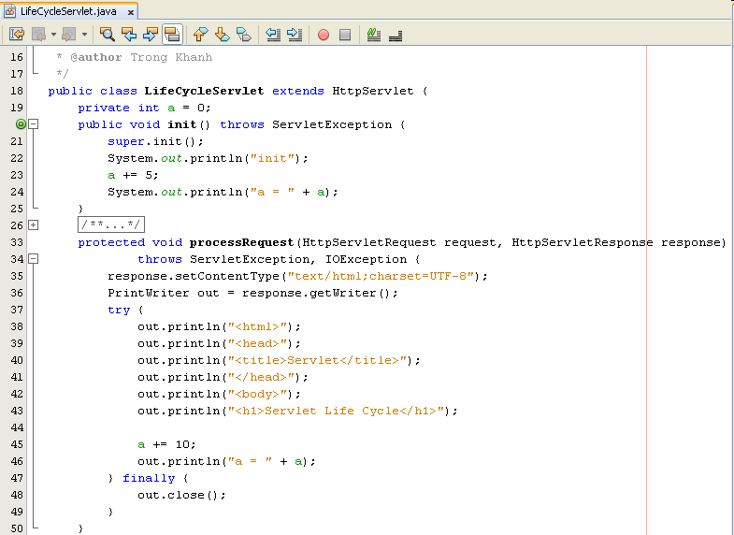
The Servlet Model The Servlet Life Cycle – Example

Slide 56
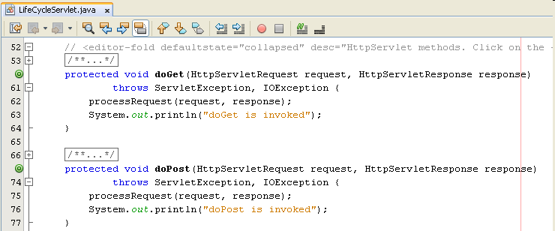
The Servlet Model The Servlet Life Cycle – Example

Slide 57
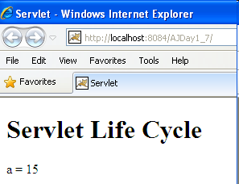
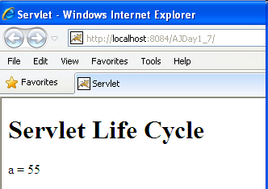
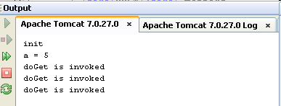
The Servlet Model The Servlet Life Cycle – Example

Slide 58
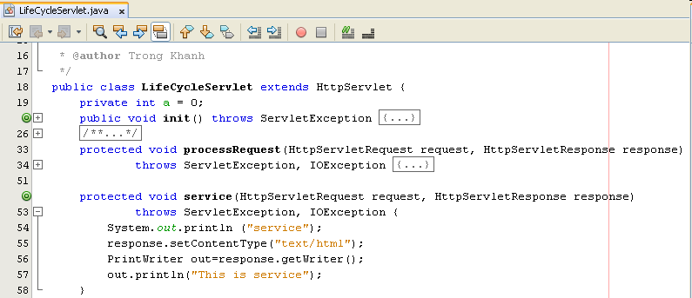
The Servlet Model The Servlet Life Cycle – Example

Slide 59
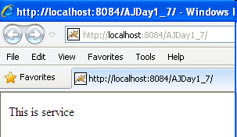

The Servlet Model The Servlet Life Cycle – Example

Slide 60
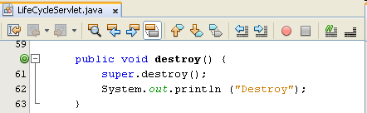
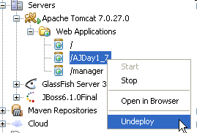
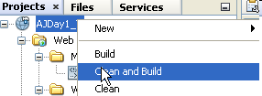

The Servlet Model The Servlet Life Cycle – Example
Addition the destroy method (comment service method)
Execute project again, then undeploy or clean and Build the current project on Tomcat Server

Slide 61
Summary
How to build the simple web site using html and servlet?
Http Protocol and Methods
What is Servlet?
Parameters vs. Variables
Servlet Life Cycle
Break down structure component in building web application
Q&A

Slide 62
Exercises
Do it again all of demos
Using html and servlet to write the programs as the following requirement
Present the Login form named Login.html with title Login, header h1 – Login Page, 02 textbox with named txtUserName and txtPassword, 01 button named Login (type Submit) and 01 buttoen named Reset (type : Reset)
Writing the ColorServlet that presents “Welcome to Servlet course” with yellow in background and red in foreground

Slide 63
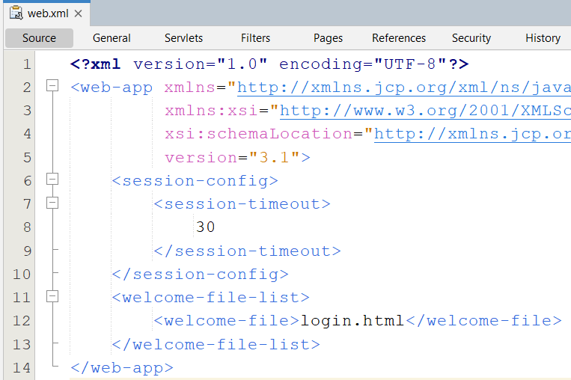


Solved Exercises

Slide 64

Solved Exercises

Slide 65


Solved Exercises

Slide 66
Next Lecture
How to access database from web application?
JDBC
Relational Database Overview
JDBC and JDBC Drivers
JDBC Basics: Processing SQL Statements
Implement CRUD application using MS SQL

Slide 67
Practice
Do Lab01_Servlet.pdf

Slide 68



Lab 01
Create an Java web application contains the web page as the follows (use Html and Servlet):
-Login page: If user name is “admin” and password is “admin” the
redirect to the CreateBook.html , otherwise redirect to the
LoginFailed.html

Slide 69


Lab 01 (cont.)
CreateBook.html page : The user enters all information of the book and presses the create button to view detailed information of the created book

Slide 70




Appendix Build Application
Package War file with command prompt
jar –cvf fileName.war directoryOrFile
Ex: jar –cvf AJDay1_7.war *.jsp WEB-INF/*
Notes:
D:\Training\JavaWeb\Demo\IntroductionJSP\build\web>jar -cvf introjsp.war *.jsp WEB-INF/*

Slide 71

Appendix -The Servlet Model ServletRequest interface
Provides access to specific information about the request
Defines object (ServletRequest object)
Containing actual request (ex: protocol, URL, and type)
Containing raw request (ex: headers and input stream)
Containing client specific request parameters
Is passed as an argument to the service() method
Some methods

Slide 72


Appendix – The Servlet Model HttpServletRequest interface – Ex01

Slide 73

Appendix – The Servlet Model HttpServletRequest interface – Ex01

Slide 74

Appendix – The Servlet Model HttpServletRequest interface – Ex01

Slide 75

Appendix – The Servlet Model HttpServletRequest interface – Ex02

Slide 76

Appendix – The Servlet Model HttpServletRequest interface – Ex02

Slide 77

Appendix – The Servlet Model HttpServletRequest interface – Ex02

Slide 78


Appendix – The Servlet Model HttpServletRequest interface – Ex03

Slide 79

Appendix – The Servlet Model HttpServletRequest interface – Ex03

Slide 80

Appendix – The Servlet Model HttpServletRequest interface – Ex03

Slide 81




Appendix – The Servlet Model HttpServletRequest interface – Ex04

Slide 82


Appendix – The Servlet Model HttpServletRequest interface – Ex04

Slide 83
Appendix -The Servlet Model ServletResponse interface
Is response sent by the servlet to the client
Include all the methods needed to create and manipulate a servlet’s output
Retrieve an output stream to send data to the client, decide on the content type ...
Define objects passed as an argument to service() method
Some methods
Methods | Descriptions
getContentType | - public String getContentType() - Returns the Multipurpose Internet Mail Extensions (MIME) type of the request body or null if the type is not known - String contentType = response.getContentType();
getWriter | - public PrintWriter getWriter() throws IOException - Returns an object of PrintWriter class that sends character text to the client, particular Browser. - PrintWriter out = response.getWriter();

Slide 84
Appendix -The Servlet Model ServletResponse interface
Methods | Descriptions
getOutputStream | - public ServletOutputStream getOutputStream() throws IOException - Uses ServletOutputStream object to write response as binary data to the client. - ServletOutputStream out = response.getOutputStream(); - 02 supporting methods + public void print(boolean b) throws IOException . writes a boolean value to the client with no carriage return line feed (CRLF) character at the end . out.print(b); + public void println(char c) throws IOException . same as the print methods but it writes a character value to the client, followed by a carriage return line feed (CRLF)
setContentType | - public void setContentType(String str) - Used to set format in which the data is sent to the client, either normal text formate or html format - Ex: response.setContentType(“text/html”);

Slide 85
Appendix-The Servlet Model HttpServletResponse interface
Extends ServletResponse Interface
Defines HttpServlet objects to pass as an argument to the service() method to the client
Set HTTP response, HTTP header, set content type of the response, acquire a text stream for the response, acquire a binary stream for the response, redirect an HTTP request to another URL or add cookies to the response
Methods | Descriptions
encodeRedirectURL | - public String encodeRedirectURL (String url) - Encodes the specified URL for use in the sendRedirect method, or if encoding is not needed, returns the URL unchanged
sendRedirect | - public void sendRedirect(String URL) throws IOException - Sends a redirect response to the client using the specified redirect location URL - the servlet using the sendRedirect method to decide the request handled by particular servlet or - Ex: response.sendRedirect(“process.jsp”);

Slide 86

Appendix – The Servlet Model HttpServletResponse interface - Example

Slide 87

Appendix – The Servlet Model HttpServletResponse interface - Example
Using sendRedirect

Slide 88

Appendix – The Servlet Model HttpServletResponse interface - Example

Slide 89
Appendix-The Servlet Model HttpServlet class
The protocol defines a set of text-based request messages called HTTP ‘methods’ implemented in HttpServlet class
Provides an abstract class to create an HTTP Servlet
Extends the GenericServlet class
A subclass of HttpServlet class must override at least one of the following methods: doGet(), doPost, doPut(), doDelete(), init(), destroy(), and getServletInfo
Some methods to process the request
Methods | Descriptions
doGet | - protected void doGet(HttpServletRequest req, HttpServletResponse res) throws ServletException, IOException - called by container to handle the GET request. - This method is called through service() method
doPost | - protected void doPost(HttpServletRequest req, HttpServletResponse res) throws ServletException, IOException - called by container to handle the POST request. - This method is called through service() method

Slide 90

Appendix-The Servlet Model HttpServletRequest interface
Extends ServletRequest Interface
Add a few more methods for handling HTTP-specific request data
Defines an HttpServletRequest object passed as an argument to the service() method

